Slide 1

Windows, Mirrors and Sliding Glass Doors
Alexis Saldana
This Photo by Unknown author is licensed under CC BY-SA.

Slide 2
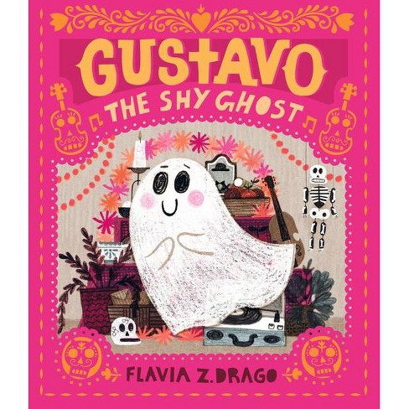
Gustavo The Shy Ghost
Author and Illustrator: Flavia Z. Drago
Description: This story tells of shy ghost named Gustavo who is very afraid to make friends and feels invisible. He is also a musician in hopes of making friends, invites every monster in town to attend his violin concert on Dias De Los Muertos.
Connections: Establishing relationships when shyness is difficult as well as showcasing things from Hispanic culture. (I.e. Dias De Los Muertos)
Musical Connection: Can be an introduction to the violin, can use the ghost noises as vocal exploration and can even create a song based on the places he hid from his friends or other fun things within the book
Youtube link:https://www.youtube.com/watch?v=PiTnh3hPwEw
Category: Mirror-because this book showcases feelings that many students may feel from being shy to sad and many feelings in between. As well as showing different things from Hispanic cultures I saw things I have seen my whole life and made me connect with this book.

Slide 3
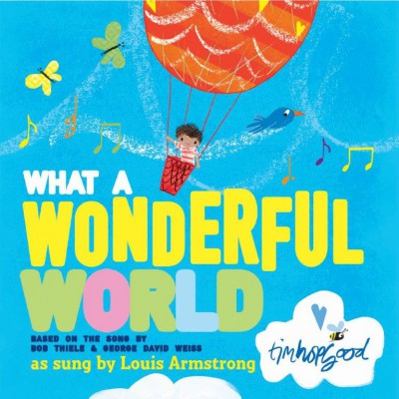
What a Wonderful World
Author: Bob Theile, George David Weiss Illustrator: Tim Hopgood
Description: A picture book created from the song that was made famous by the incomprable Louis Armstrong. A sweet and positive book that incorporates the small joys of life with music. Great visuals to go along with the text as well as deep feeling of hope throughout.
Connection: Brings a familiar song and a message of hope to the reader that can be shared over and over again
Youtube Link: https://www.youtube.com/watch?v=UYbKOUzfMHY
Musical Connection: There is already a song connected to this, and I think if you created an orffistration of it including recorders and other orff instruments this could be a solid lesson plan with singing planning and rhythm
Category-Mirror: Because this song is so well known or can be shared with others in a meaningful way I believe it is a mirror. Students can see the hope in the text as well share that with others. I listened to this song many times as a child and I see bits of myself within this book through the messages of hope

Slide 4
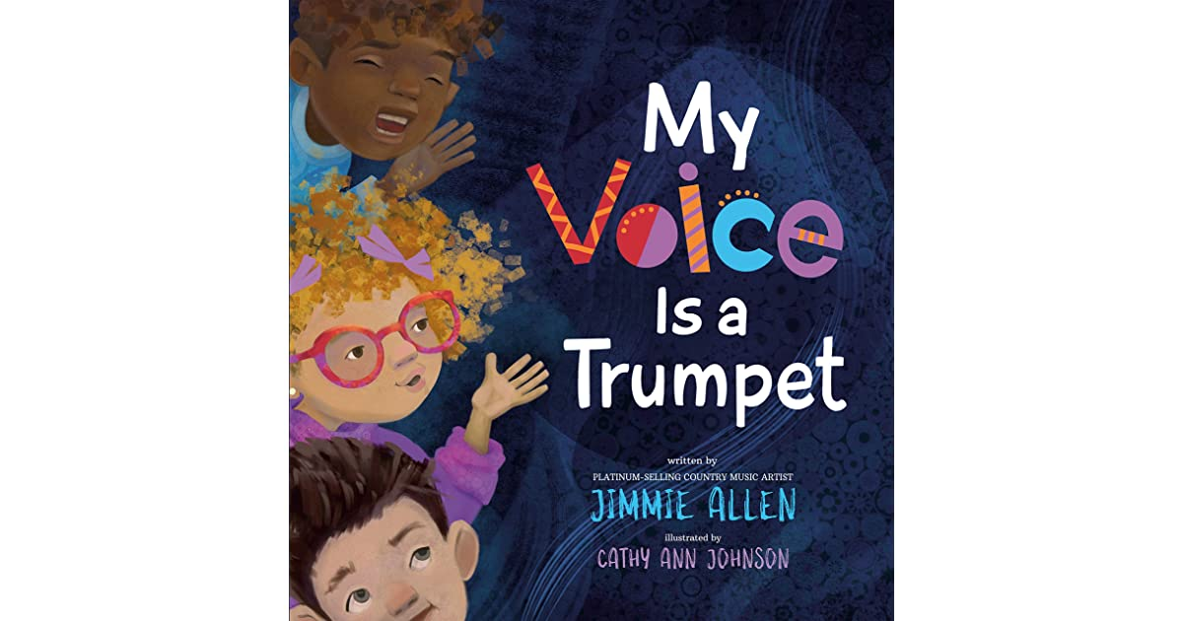
My Voice is a Trumpet
Author: Jimmie Allen
Illustrator: Cathy Ann Johnson
Description: With voices big and small all it takes is confidence and a belief in the goodness of others to change the world. It is a poetic book about representation and using your voice to stand up for what believe in no matter age or size.
Connection: Shines a light on social justice in a welcoming and insprining way by comparing our voice to loud instruments and showing change can happen no matter big or small.
Youtube link: https://www.youtube.com/watch?v=E2NUqApUhw8
Musical Connection: Using the context words for loud and soft to learn piano and forte dynamics and do vocal exploration in both. There is also introductions to instruments such as the trumpet and could be a great segway into an instrumental lesson.
Category- Mirror: The students see and hear words of encouragement surronding having confidence and bravery in hard times. Everyone should see themselves in and hopefully be able to learn not just fun music things but also great skills for life

Slide 5
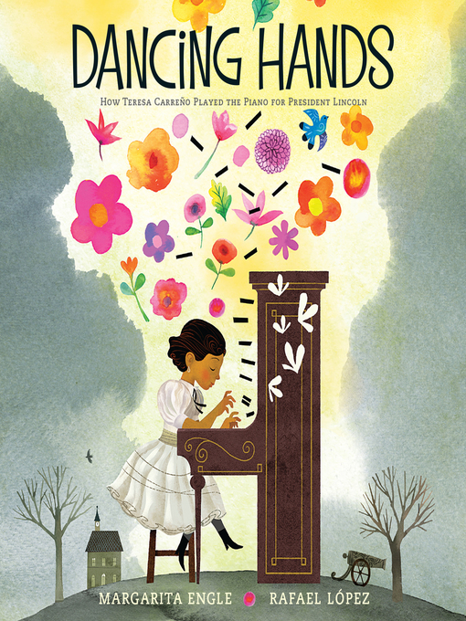
Dancing Hands: How Teresa Carreno Played the Piano for President Lincoln
Author: Margarita Engle Illustrator: Rafael Lopez
Description: The incredible story of Teresa Carreno and her journey playing piano through difficult times while her family was immigrating to the United States from war ridden Venezuela and finding her way and her passion for piano once again.
Connection: Shows the difficult journey of immigrating to the states as well as finding a new home in your new country. Whether that home is 4 walls or a home is a feeling.
Youtube link: https://www.youtube.com/watch?v=PF4bVOH7E_U
Musical Connection: Since the story is about someone who loves the piano I would tape certain keys on the piano and number them for students to create a song in a certain key while the other students play on a recorder or other Orff instruments
Category-Window: Because I believe the students will see into someone elses life who has had to immigrate and move away from everything they have known as well as a window into a culture that is not very well known. Although I may have students who have immigrated I think this is also a great window into history and what someone from another country had to go through during those times.

Slide 6
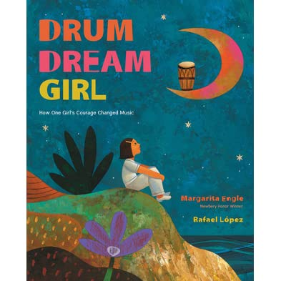
Drum Dream Girl: How One Girls Courage Changed Music
Author: Margarita Engle Illustrator: Rafael Lopez
Description: Girls cannot be drummers was the rule on an island filled with music, no one questioned that rule until the drum dream girl. In her city of drumbeats, she dreamed of hitting tall congas and tapping small bongós. She had to keep quiet or she may be caught so she had to practice in secret. But when at last her dream-bright music was heard, everyone sang and danced and decided that both girls and boys should be free to drum and dream.Inspired by the childhood of Millo Castro Zaldarriaga, a Chinese-African-Cuban girl who broke Cuba's traditional taboo against female drummers, Drum Dream Girl tells an inspiring true story for dreamers everywhere.
Connection: Inspiring young people to follow their dreams no matter what and do what they love!
Youtube link:https://www.youtube.com/watch?v=cfMSbC7T6Jw
Musical Connection: With drumming being incoporated into the book it’s a great time to learn some drumming with a djembe or other drums. You can infuse the reading with rhythm by having the students tap a certain rhythm everytime they hear a word or create a small Orffistration
Category-Window: Because the students will look into someone elses culture and learn what Millo went through just to follow her passion of drumming

Slide 7

All Are Welcome
Author: Alexandra Penhold Ilustrator: Suzanne Kaufman
Description: While reading readers will find a school where all young children have a place, have a space, and are loved and appreciated.Readers will follow a group of children through a day in their school, where everyone is welcomed with open arms. A school where students from all backgrounds learn from and celebrate each other's traditions. A school that shows the world as we will make it to be.
Connection: It showcases cultures from all around the world and gives our students a glimpse into other worlds
Youtube link: https://www.youtube.com/watch?v=aZXnMS6r_h0
Musical Connection: There is a repetetive line throughout the story of " All are welcome here" we could create a fun rhythm game turning that phrase into a rhythm and then repeating everytime it is used within the book
Category-Windows: Because it shows glimpses into other cultures and creates a view into other peoples world throughout the story through the pictures

Slide 8
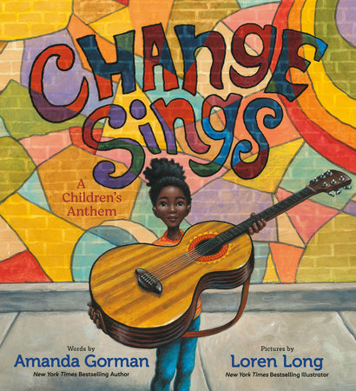
Change Sings
Author: Amanda Gorman Illustrator: Loren Long
Description: Poetic picture book depicting what could happen if our children unite. A young girl leads a cast of colorful characters on a musical journey. Throughout their journey they learn that they have the power to make changes in the world, in their communities, and in most importantly, in themselves.
Connection: Shines a light on racism and changes that are needed within our society
Youtube Link: https://www.youtube.com/watch?v=82h3PV807Iw
Musical Connection: There is a strong rhythmic feeling throughout the book and I believe we could make a great rhythm exercise and even an Orff lesson if we add in instruments. Could also connect to ukulele lesson or guitar lesson.
Category-Sliding Glass Door: I believe this book is an excellent view into people lives who struggle with racial inequality as well as the subtle microaggression some people in our country have to endure. It also shows us uniting through it all. It also invites you in to also be apart of it stepping into the world

Slide 9
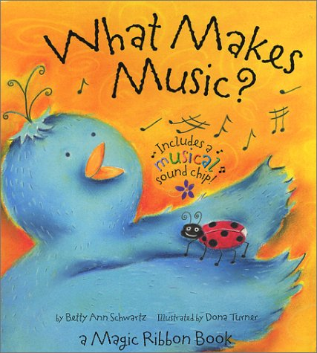
What Makes Music?
Author: Betty Ann Schwartz Illustrator: Dona Turner
Description: A family of birds introduces early readers to music, note by note. Colorful ribbons add more pizzazz--one for each musical note--that thread the book together as each page adds a shiny new ribbon.While learning their Do Re Mi, the students go through a full adventure with birds to learn all notes.
Connection: Uses fun imagery and colorful illustrations to show students music
Youtube link: https://www.youtube.com/watch?v=owr0TAt62Ng
Musical Connection: Thes book is already centered around music but it can introduce solfege to students so teaching them their solfege hand signals and getting them to understand tonal centers of pitch. Because they also have birds so fun puppets and other animal props could be very fun and useful. We could also do a fun bird "wire" with the music staff to create musical pieces
Category-Sliding Glass Doors: Because this book is just a fun fantasy with birds teaching the lesson it’s a great way for students to be immersed and use their imaginations to learn to beginnings of music and dive into a new world with bird friends

Slide 10
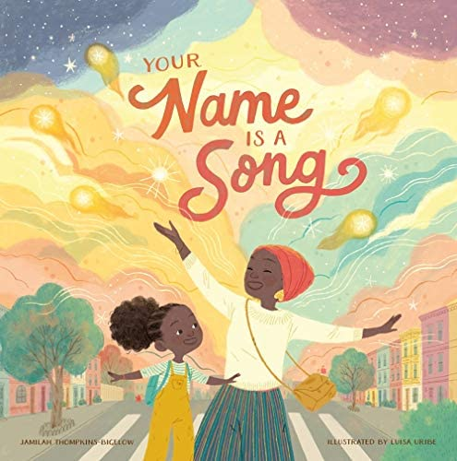
Your Name is a Song
Author: Jamilah Thompkins-Bigelow Illustrator: Luisa Uribe
Description: Frustrated by a day full of teachers and classmates mispronouncing her beautiful name, a little girl tells her mother she never wants to come back to school. In response, the girl's mother teaches her about the musicality of African, Asian, Black-American, Latinx, and Middle Eastern names on their walk home through the city. Empowered by this knowledge, the young girl is ready to return the next day to share her knowledge with her class.
Connection: Bringing in other cultures and names that are uncommon in our community to make those students feel visbile as well as stepping into the world of others we may not have experience in
Youtube link: https://www.youtube.com/watch?v=T8wAyYaM1tc
Musical Connection: In the story the Mama talks about how certain names have rhythm and direction so I would follow that from within the book and do rhythm excercises on their laps and alternate between different ones that cooridnate with the names introduced in the book
Category-Sliding Glass Door: Because the student will be transported into a world that they may have never experienced before because they have never had to struggle with these problems, and it is a way to experience it

